Slide 1
John Deere Tweet Analysis Programming in R
Lee Goodlove, Michael Coyle, Matt Knabel, Austin Cappaert & Reed Harris

Slide 2


Agenda
The Initiation
Problem Statement
The Investigation
Data Source
Transformation
Research & Insight
Conclusion
Challenges & Constraints
If we had more time

Slide 3
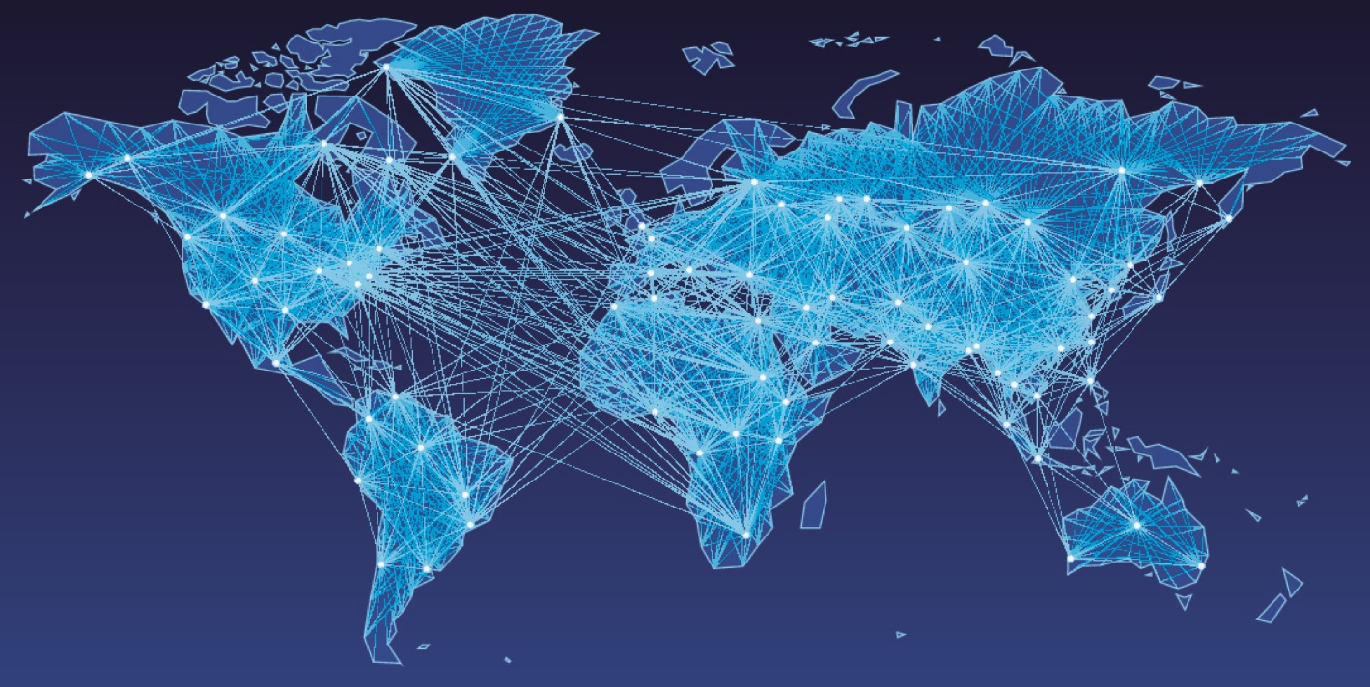
Problem Statement
Social Media Allows for Free & Instant Communication
What information is being shared about John Deere on Twitter?
Created a simple app that uses Twitter’s APIs that calls Deere’s Twitter mentions
Team has completed an investigation on the following topics:
Word Network
Hashtags
Sentiment
Tweet Time & Source
Translation

Slide 4
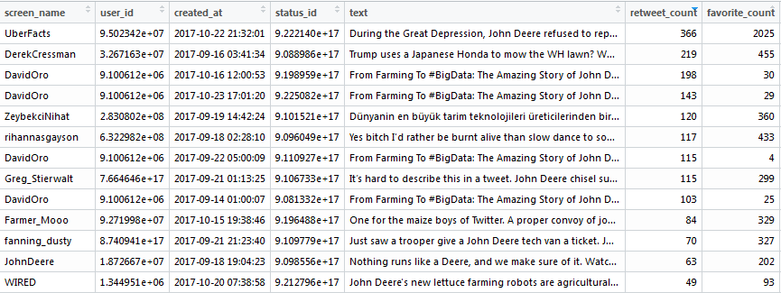
Investigation
Data Source
Twitter’s Free API
Register as a Developer
Creating an APP to Generate a key & Secret Key through OAuth Token
Tweets pulled from 10 days at a time
Used 3 different data sets

Slide 5
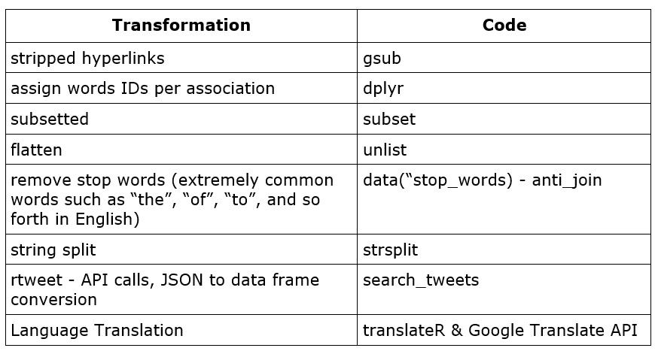
Investigation

Slide 6
Research & Insight
Word Network
Hashtags Analysis
Sentiment Analysis
Tweet Timing Analysis
Tweet Source Analysis
Translation

Slide 7
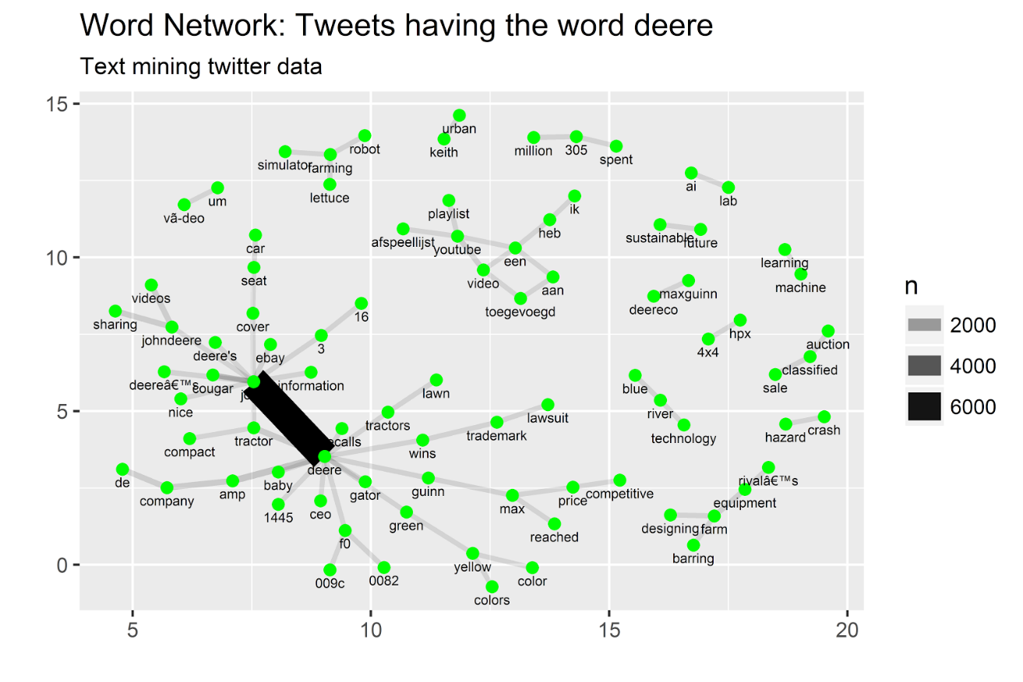
Word Network How do unique words sequence together?
Process:
dplyr package to unnest each word in own row in a new df
Remove punctuation & move to lowercase
Pair unique words together user tidyr
Strong connection between ‘John’ & ‘Deere’
Update all occurrences of John’ to ‘Deere’

Slide 8
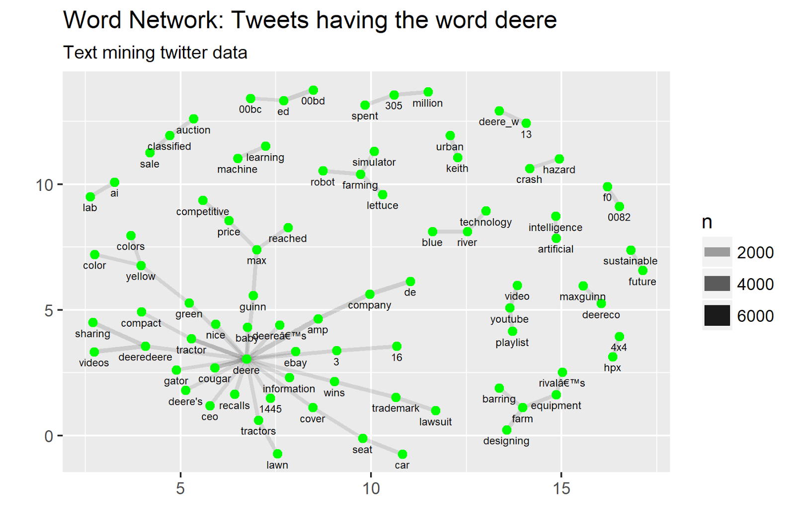
Word Network How do unique words sequence together?

Slide 9
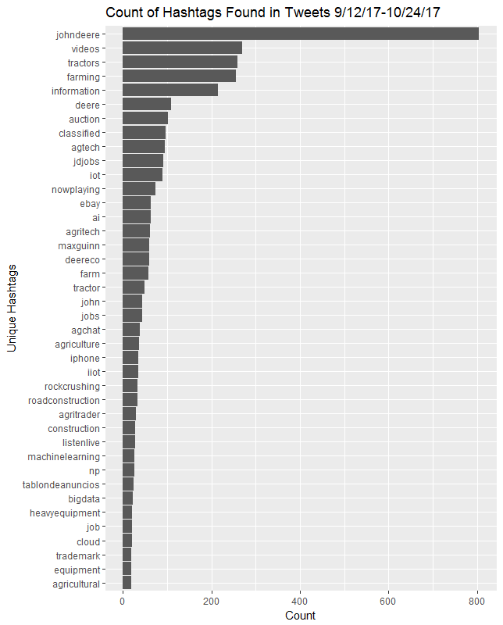
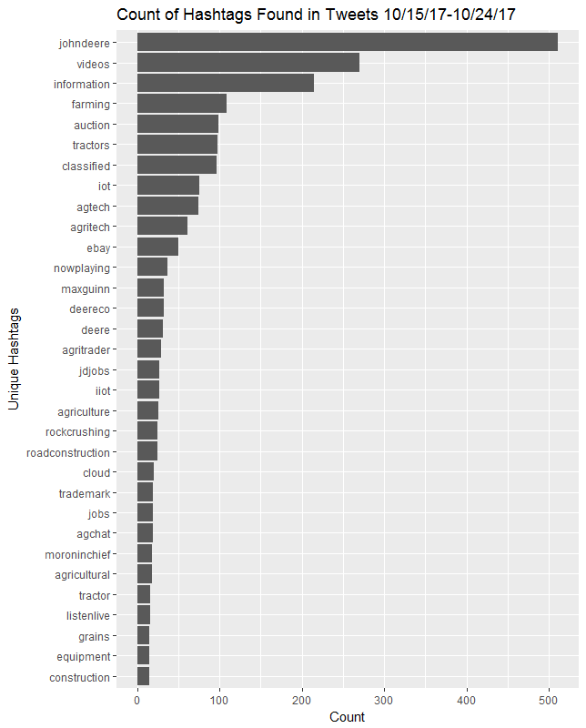
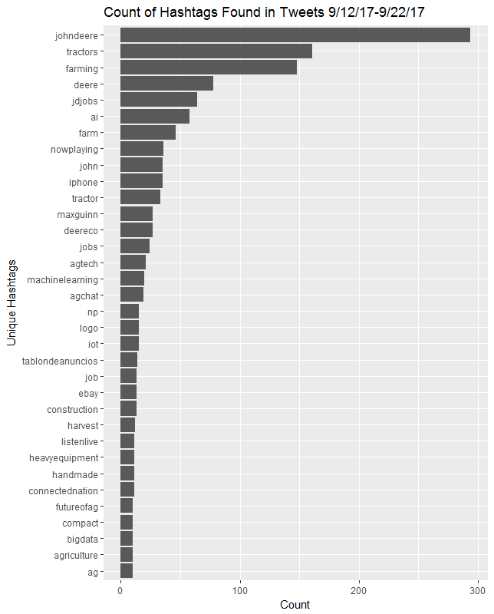
Hashtags catchy, short/concise, clear and relatable
Process:
6,200 unique hashtags
Exist as a column in data frame
Removed NA’s
Had to separate by ‘ ’ for tweets with multiple hashtags per tweet
Analysis from each time frame tells a different story

Slide 10
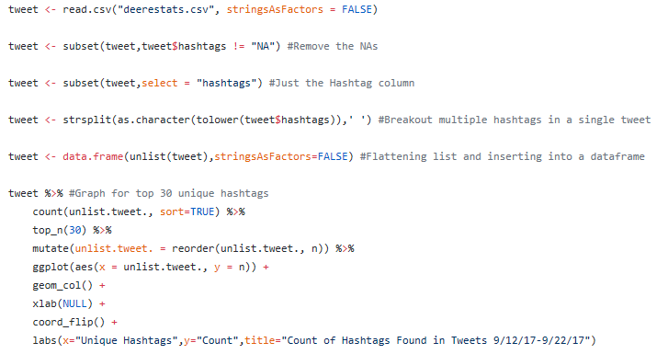
Hashtags

Slide 11
Sentiment Analysis
Analysis of the Sentiment in text can be very telling
Used the tidytext R package
nrc sentiment lexicon dataset & plotted results
Analyzed to positive, joy, trust, negative, anger and disgust words
More positive sentiment than negative sentiment
Sentiment Analysis is very subjective & challenging

Slide 12
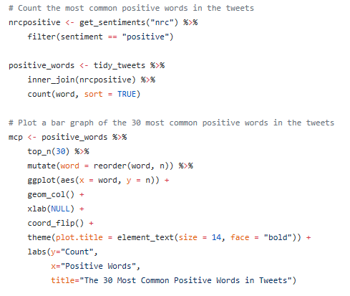
Sentiment Analysis

Slide 13
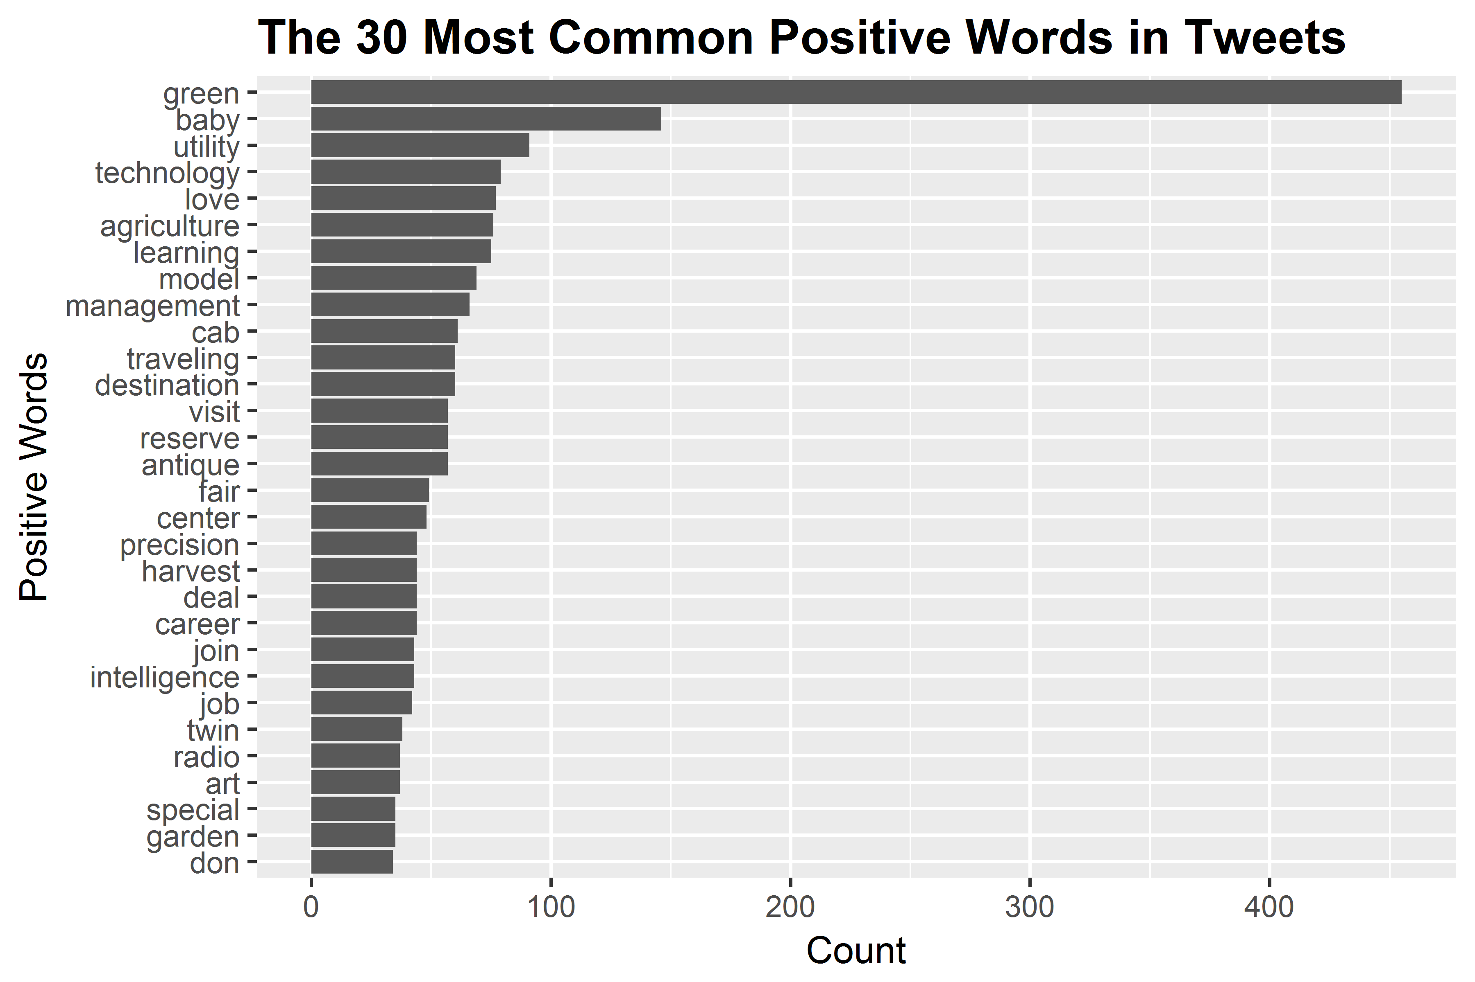
Sentiment Analysis
Notes:
Sentiment analysis could be used by Deere marketing to determine the feelings people have about John Deere and their products to help them tailor the focus of marketing strategies.

Slide 14
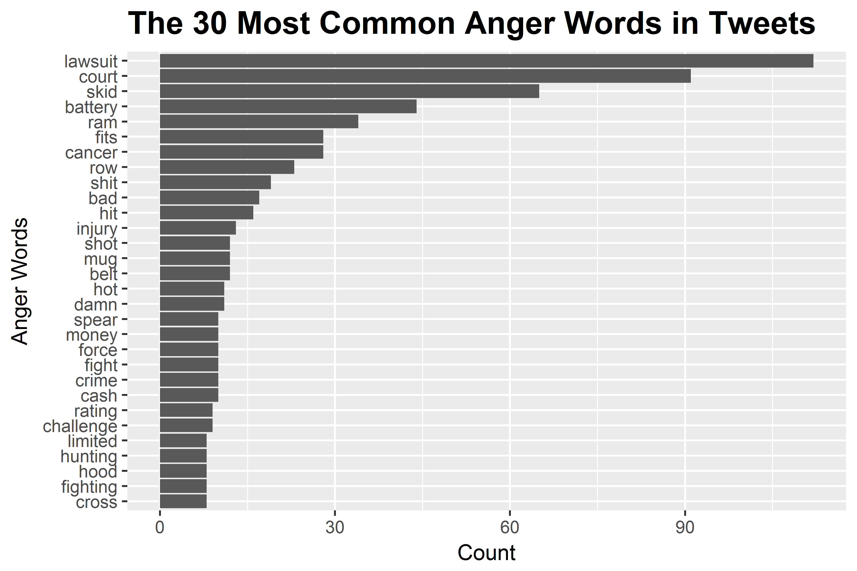
Sentiment Analysis
Notes:
The greatest number of negative words in the tweets were found when comparing to the anger words in the nrc lexicon. Words lawsuit and court were the most prevalent anger words in the tweets.

Slide 15
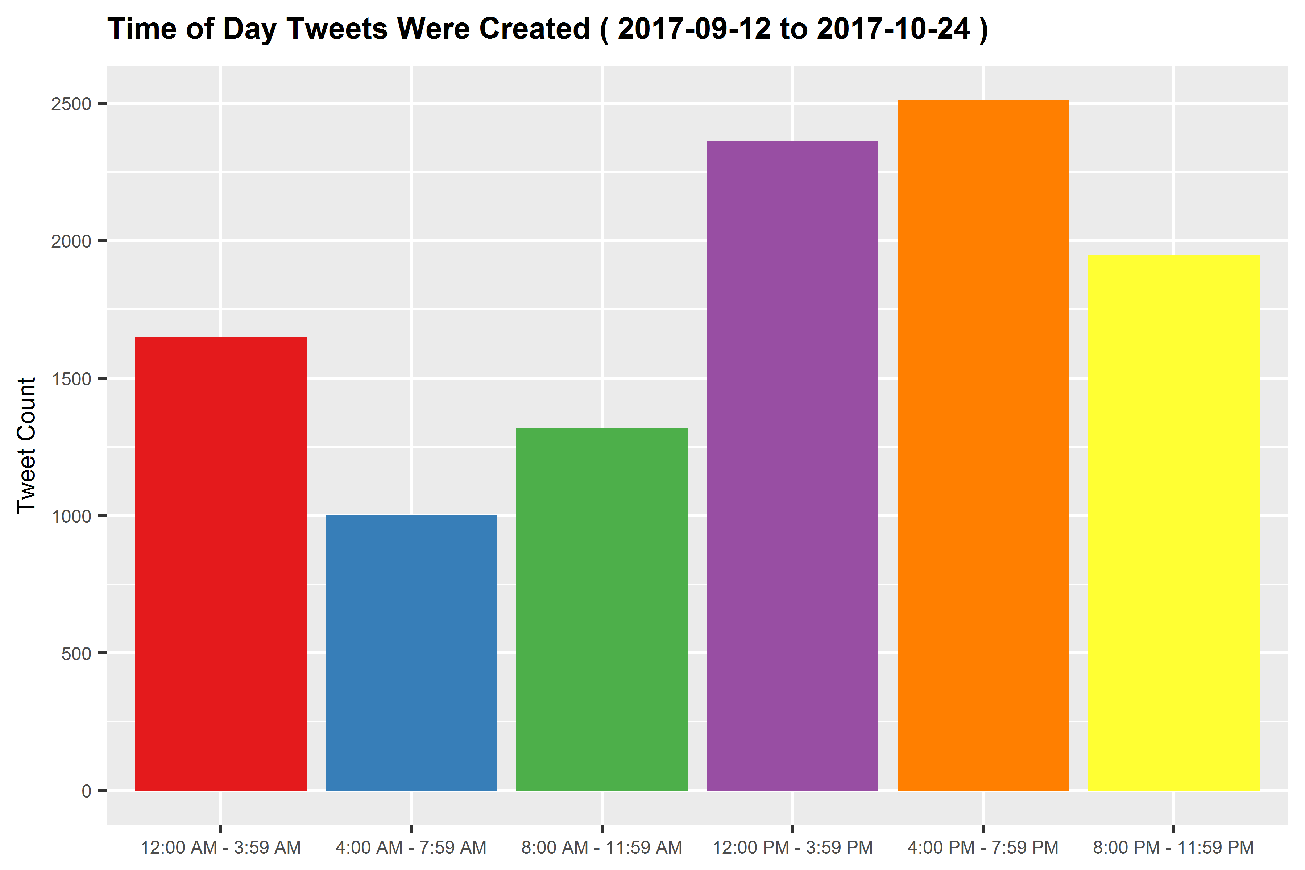
Tweet Date / Time Analysis
Notes:
We grouped the tweets in 4 hour time blocks and plotted the count of tweets created in those blocks.
We expected there would be more tweets in the middle of the day and in the evening.
Our research has shown that people use Twitter most often from noon to 1:00 PM. Our data aligns with this.
John Deere could use this information to help them determine the best times of the day to advertise.
John Deere could use this information to help them determine the best times of the day to advertise.

Slide 16
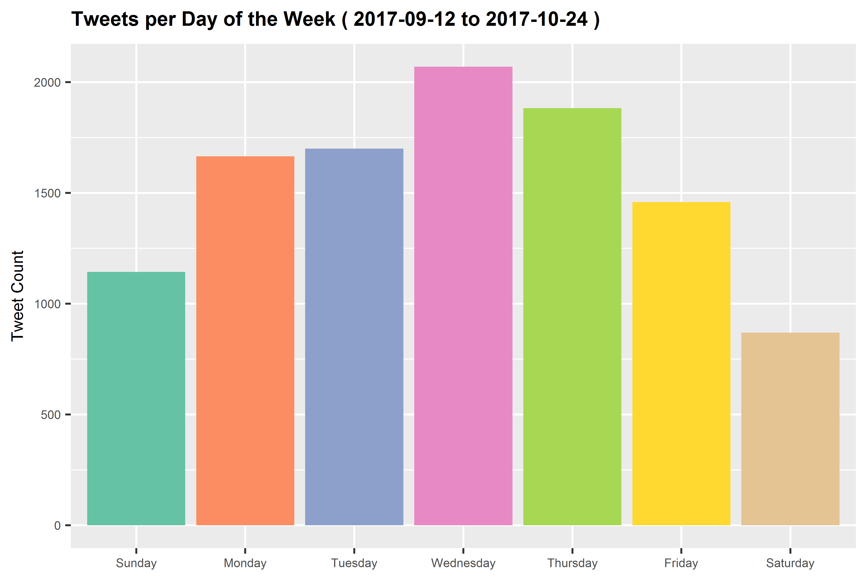
Tweet Date / Time Analysis
Notes:
We also used the date time stamp data to plot the days of the week when people tweet most about John Deere.
We were surprised to see that Wednesday is the day with the greatest number of tweets. We expected most tweets to occur on the weekends.
We researched this and found that Wednesday is the most common day of the week that people tweet.
We wrote a function that takes a date range from the user to plot this data. Users could use this function to see trends in the days of a week that people tweet about John Deere.

Slide 17
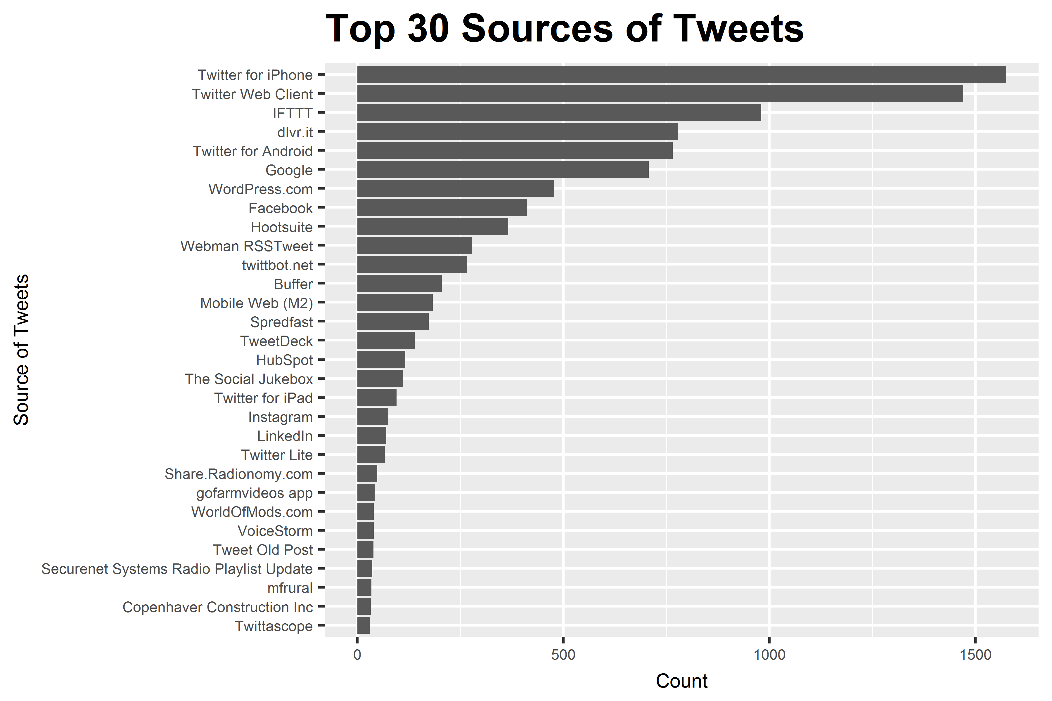
Tweet Source Analysis
Notes:
The source of tweets is one of the columns of the Deere tweet data, e.g. Twitter iPhone app, Twitter Android app, Twitter web page etc.
There are approximately 400 sources that tweets came from in our dataset.
We counted each of the tweet sources and plotted the top 30.
This data could be used by John Deere to target how and where to advertise.

Slide 18
Translation
Gained additional insight by translating other languages to English
Translated top 6 languages
French, Spanish, Portuguese, Dutch, German & Japanese
Google Translate API has limitations
Can translate 1 million characters per 100 seconds
Service would cost company $20 for every 1 million characters
Process:
Subset each language into separate df’s
rbind the translated df’s in a separate df
rbind translated df into df without translated text
Used translated df to build graphs

Slide 19
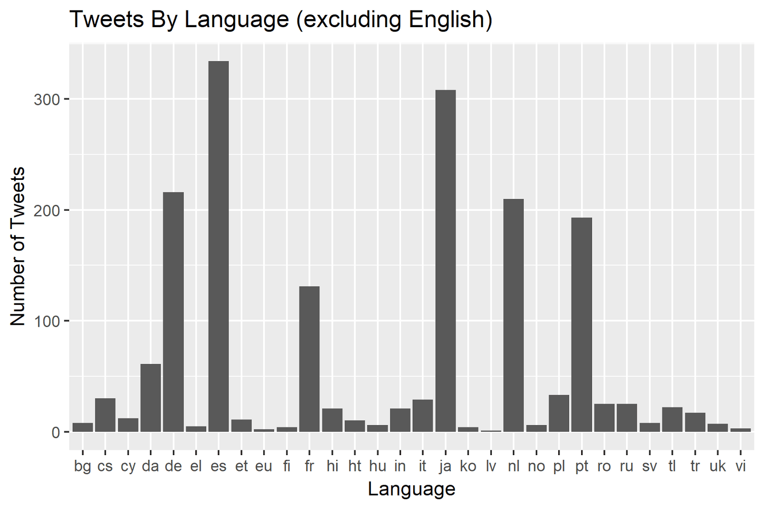
Translation

Slide 20
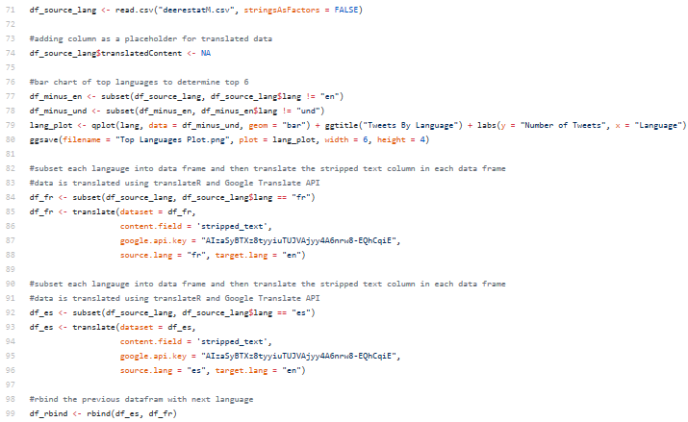
Translation

Slide 21
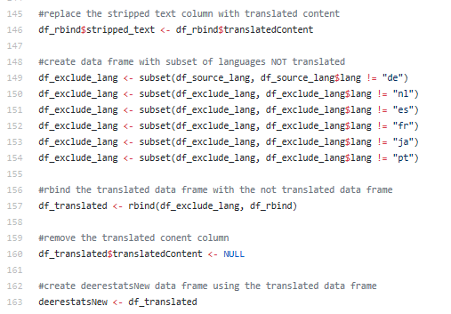
Translation

Slide 22
Conclusion
Challenges & Constraints
Limitation of Free Twitter API
10 Day Tweet Limit
18,000 Tweets per 15 Minutes
Reliability of Twitter’s API
JSON calls not having the same number of rows in each column
Packages & Different Versions of R

Slide 23
Conclusion
If We Had More Time…
Better understanding of Twitter’s API & rtweet earlier in the process
Would have lead to a larger data set to work from
Could have seen spikes during harvest or planting
Emoji Analysis
Translation
Could have completed more languages
Japanese Unicode
Refine Code & Reports to present within John Deere

Slide 25

Question & Answer

